Slide 1
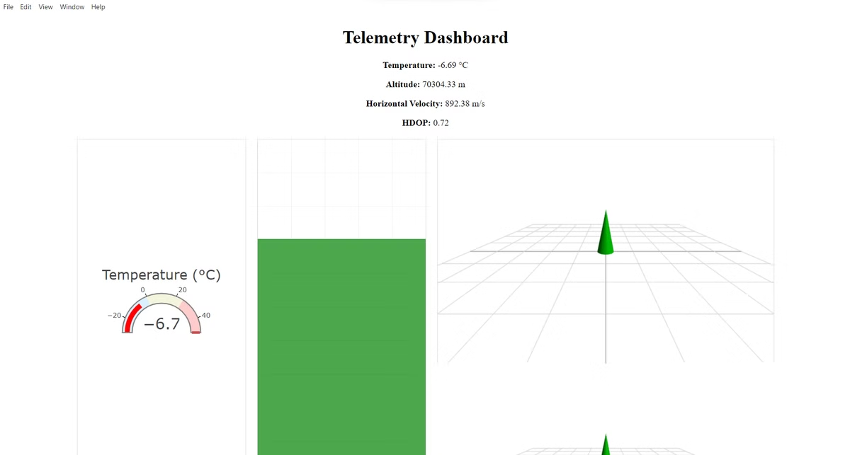
EdTech Rocketry
Aditya Rajmane
Sanchita Jadhav
Center for Educational Technology

Slide 2
Project Overview: Bridging Theory and Practice
Simulation Purpose
Real-time Telemetry
Our simulation recreates rocket flight dynamics with high fidelity. It allows scientists to visualize launch conditions without physical constraints.
Live data streams mirror actual aerospace missions. This approach enhances understanding of critical flight parameters and decision-making processes.

Slide 3

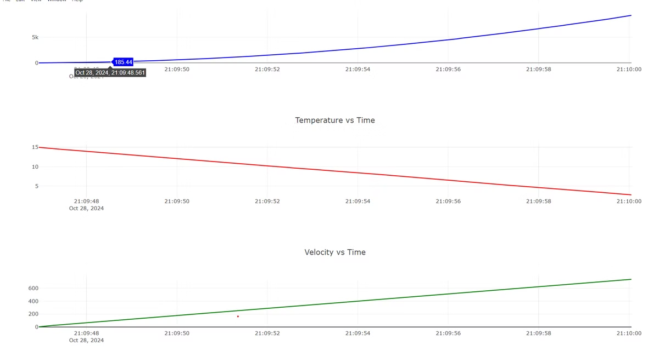
Key Simulation Goals: Enhancing Aerospace Education
1
Flight Stage Simulation
2
Telemetry Generation
Accurate modeling of launch, ascent, coasting, and descent phases. Students can observe crucial transitions and events during each stage.
Production of realistic data streams mimicking actual rocket sensors. This includes altitude, velocity, temperature, and orientation metrics.
3
Educational Analysis
Tools for in-depth data examination and interpretation. Students learn to extract insights and make informed decisions based on telemetry.

Slide 4

Rocket Flight Phases: A Comprehensive Journey
1
Launch
Initial thrust overcomes gravity. Rocket accelerates rapidly, experiencing maximum stress on structure.
2
Ascent
Continued acceleration through the atmosphere. Rocket encounters increasing air resistance and decreasing air pressure.
3
Coasting
Engines cut off. Rocket continues upward trajectory solely due to momentum.
4
Descent
Gravity takes over. Rocket falls back to Earth, potentially deploying parachutes for controlled landing.

Slide 5
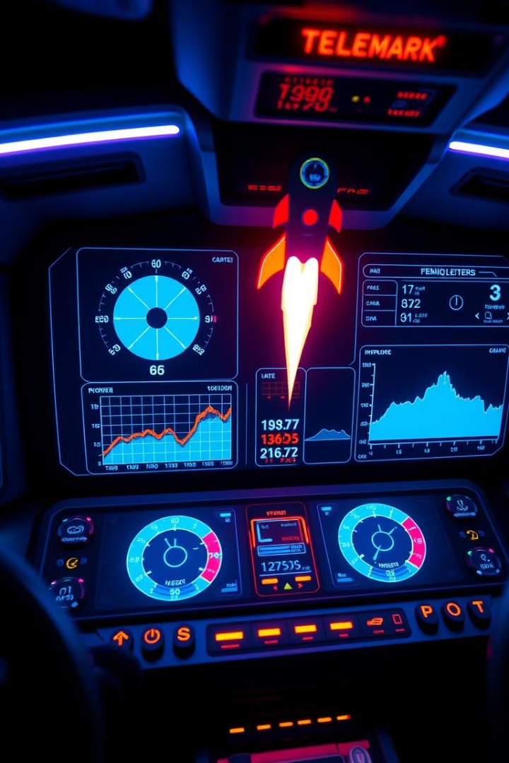




Comprehensive Telemetry Data: The Pulse of the Rocket
Altitude
Temperature
Measures a rocket's height above ground level. Critical for tracking flight progress and trajectory.
Monitors external and internal temperatures. Crucial for assessing atmospheric conditions and engine performance.
Velocity
Orientation
Tracks speed and direction. Essential for understanding rocket's momentum and flight path.
Measures rocket's Acceleration using BNO sensors. Vital for maintaining stability and correct flight path.

Slide 6
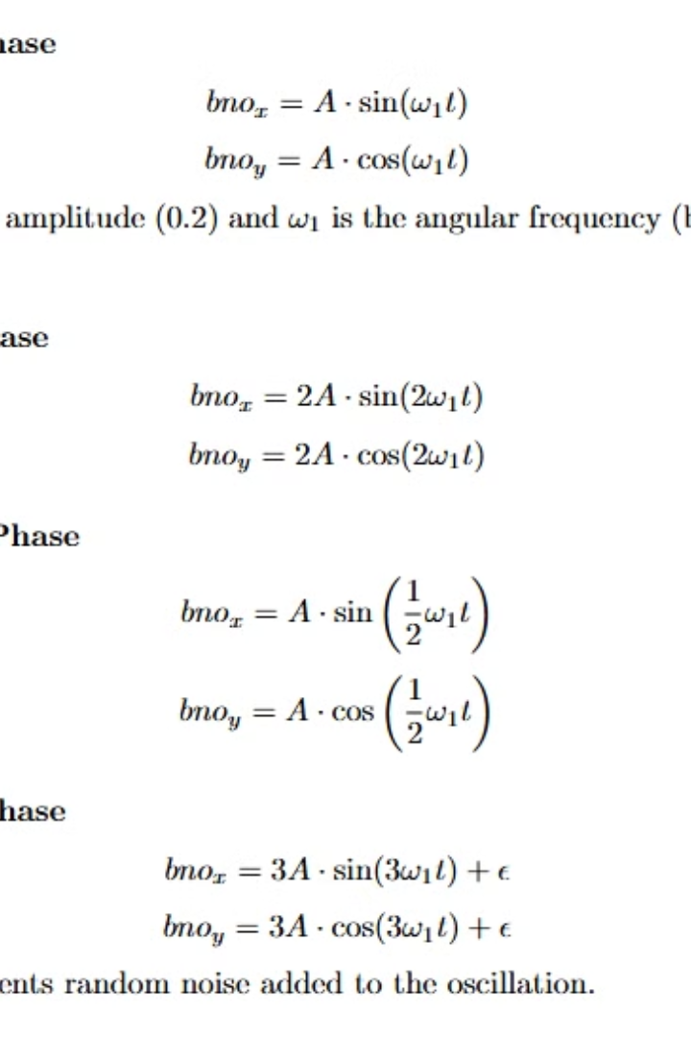
Randomness in Data: Simulating Real-World Variability
Real-World Conditions
Altitude Variations
Randomness mimics unpredictable factors like wind gusts, atmospheric turbulence, and minor mechanical variations.
Small fluctuations in ascent rate simulate air density changes and thrust inconsistencies.
Acceleration Dynamics
Random accelerations reflect complex interplay of forces acting on the rocket during flight.

Slide 7




Orientation Data: Keeping the Rocket on Course
Stability Role
Update Mechanism
Flight Stage Patterns
Precise orientation data ensures rocket maintains intended flight path. It's crucial for mission success.
Orientation values updated continuously using BNO sensor data. This provides real-time attitude information.
Oscillation patterns vary based on current flight stage. Launch sees rapid changes, while coasting is more stable.

Slide 8
Real-time Data Transmission: The Power of WebSocket
WebSocket Technology
Real-time Benefits
Webapp
Enables bi-directional, full-duplex communication. Allows instant data streaming from rocket to ground stations.
Immediate data access enables quick decision-making. Crucial for identifying and responding to flight anomalies.
Ease of experience by making a windows webapp using Electron. Enhances engagement and understanding of aerospace operations.

Slide 9
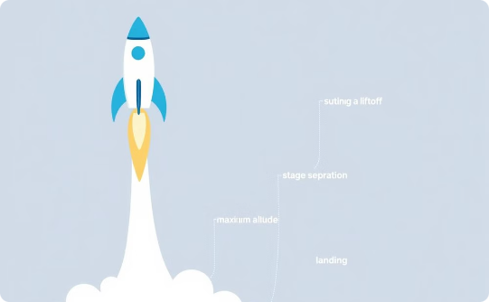
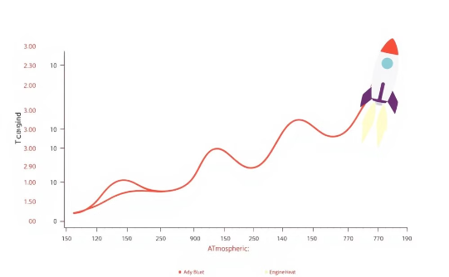

Data Visualization: Bringing Telemetry to Life
Altitude vs. Time
Temperature vs. Time
Velocity vs. Time
Tracks vertical progress of the rocket. Clearly shows different flight phases and maximum altitude reached.
Monitors thermal conditions throughout flight. Crucial for understanding atmospheric interaction and engine performance.
Illustrates speed changes during flight. Essential for analyzing thrust efficiency and atmospheric drag effects.

Slide 10

Overcoming Challenges: Innovation in Action
Challenge
Solution
Creating Realistic Simulations
Introduced randomness and complex physics models
Handling Data Volume
Optimized data compression and transmission protocols
Ensuring Real-time Performance
Implemented efficient algorithms and WebSocket technology

